Slide 1


Figure Detection
Group : 20IT07

Slide 2


Current scenario
Only text are identified from a document using ocr.
Diagram components from images are left as it is.

Slide 3

What we are trying to do…

Slide 4
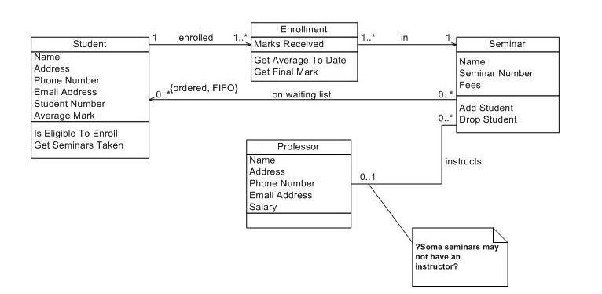
image

Slide 5
What kind of detection ?
Handwritten digits detection, symbols, figures, diagrams.
Digital diagrams and figures with utmost accuracy.

Slide 6
Benefits
What we will use ?
No need to draw or make it again in book or digitally.
Ready to share..
Fast work for bulk documents.
Python OpenCV part of machine learning.
In OpenCV, Tesseract, the CV is an abbreviation form of a computer vision.
The purpose of computer vision is to understand the content of the images.
It extracts the description from the pictures.

Slide 7
SUGGESTIONS ??

